Slide 1
Maximum Cardinality Matching
Progress Report, 7.11.2016
Isa Roesch, Samuel Ueltschi, Conradin Roffler, Thomas Meier

Slide 2
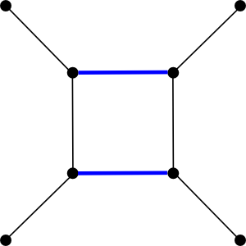
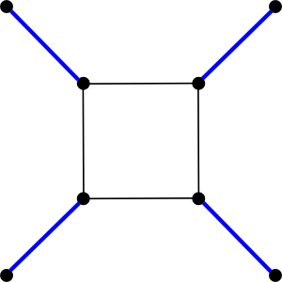
Maximum Cardinality Matching
Maximum Matching
Maximum-Cardinality Matching
Pictures taken from boost.org

Slide 3
State of the Art

Slide 4
Baseline
Sequential: Boost (Hopcroft-Karp) [1]
Parallel: Pothen-Fan [2]
[1] http://www.boost.org/doc/libs/1_59_0/libs/graph/doc/maximum_matching.html
[2] http://www.sandia.gov/~egboman/papers/ParallelMaximumMatching.pdf

Slide 5
Pothen-Fan
A
A
1
B
2
2
C
C
3
D
4
4

Slide 6
Pothen-Fan
A
A
1
B
2
2
C
C
3
D
4
4

Slide 7
Current State
First own implementation of Pothen-Fan
Future Steps
Tune parallel Pothen-Fan for Xeon Phi
Benchmark with SuiteSparse Matrix Collection
Roadmap USA
Wikipedia
Amazon.com
SparseMatrix: http://www.cise.ufl.edu/research/sparse/matrices/

Slide 8
Thank you for your attention

